Slide 1

BUSINESS ANALYSIS Business Process Improvement

Slide 2
ROOT CAUSE ANALYSIS
What is root cause analysis
“Root cause analysis (RCA) is the quality management process by which an organization searches for the root of a problem, issue or incident after it occurs.”
Triggers for root cause analysis
“Physical causes
When real-world materials or equipment fails in some way (for example, a desktop computer stops working or a component from a third-party vendor delivers substandard performance).
Human causes (or human error)
When people make mistakes or fail to complete required tasks (for example, an employee fails to perform regular maintenance on a piece of equipment, causing it to break down).
Organizational causes
A breakdown in a system, process or policy people use to make decisions (for example, a company fails to train team members on cybersecurity protocols, leaving the company vulnerable to cyberattacks).”
Source: IBM; https://www.ibm.com/think/topics/root-cause-analysis

Slide 3
HOW TO CONDUCT A ROOT CAUSE ANALYSIS
Identify the problem
Assemble the RCA team
Identify possible root causes
Determine the root causes
Find and implement the solution
Source: IBM; https://www.ibm.com/think/topics/root-cause-analysis

Slide 4
ROOT CAUSE ANALYSIS METHODOLOGIES
5 Whys
The 5 Whys approach is rooted in the idea that asking five “Why?” questions can get you to the root cause of anything.
Failure mode and effects analysis (FMEA)
FMEA identifies every possibility for system/process failure and examines the potential impact of each hypothetical failure.
Change analysis
When conducting this type of RCA, the department looks at how the circumstances surrounding the issue or incident have changed over time. Examining changes in personal, information, infrastructure, or data, among other factors, can help the organization understand which factors caused the change in performance.
Event analysis
An event analysis is commonly used to identify the cause of major, single-event problem, like an oil spill or building collapse. Event analyses rely on quick (but thorough) evidence-gathering processes to recreate the sequence of events that that led to the incident. Once the timeline is established, the organization can more easily identify the causal and contributing factors.
Source: IBM; https://www.ibm.com/think/topics/root-cause-analysis

Slide 5
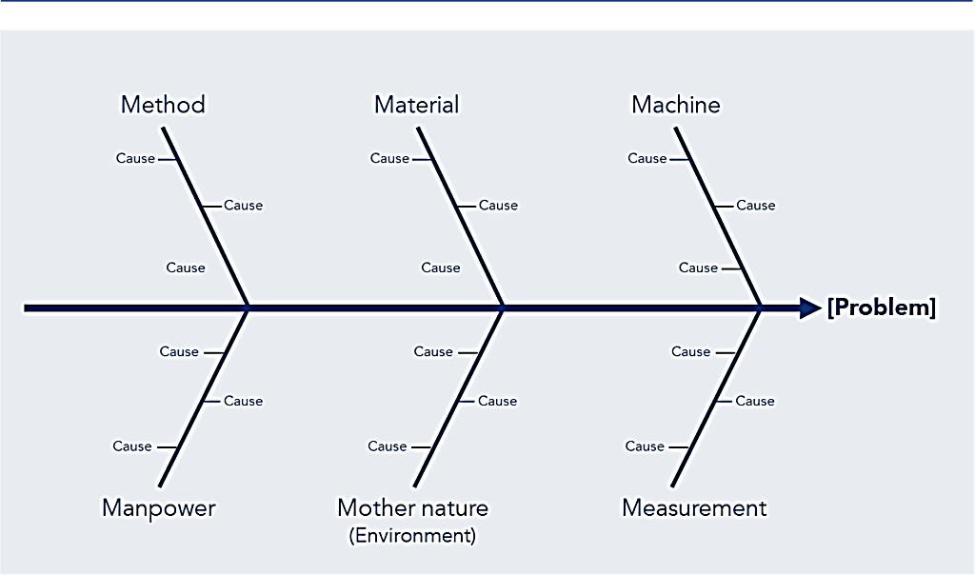
ROOT CAUSE ANALYSIS METHODOLOGIES
Example of an Ishikawa Diagram: The 6 Ms Structure
Ishikawa diagram
“An Ishikawa diagram (or Fishbone diagram) is a cause-and-effect style diagram that visualizes the circumstances surrounding a problem. The diagram resembles a fish skeleton, with a long list of causes grouped into related subcategories.”
Source: IBM; https://www.ibm.com/think/topics/root-cause-analysis
Kaizen Institute; https://kaizen.com/insights/ishikawa-diagram-root-cause-analysis/

Slide 6
BOTTLENECK ANALYSIS
What is a bottleneck in business?
“Bottlenecks are the slowest or most restrictive parts of a system, process, or workflow that hinder productivity, slow growth, and negatively impact the bottom line.”
Why should you conduct bottleneck analysis?
Bottleneck analysis is a management tool used to identify constraints and inefficiencies in a system or process that limit its capacity and productivity. It involves identifying and prioritizing the steps that take the most time, resources, or effort and analyzing them to identify the root causes of the inefficiencies. This analysis helps to pinpoint the areas for process optimization.
Source: process maker; https://www.processmaker.com/blog/bottleneck-analysis-explained/

Slide 7
HOW TO CONDUCT BOTTLENECK ANALYSIS
“In a business organization bottleneck analysis can be conducted by a business analyst or operational excellence consultant. At the simplest level, a bottleneck analysis typically involves the following steps:
Step 1: Identify the Process or System
Identify the process or system that needs analysis, such as a manufacturing process, supply chain, or customer service process.
Step 2: Map the Process
Map out the process or system, identifying each step and the resources required for each step.
Step 3: Identify the Bottleneck
Identify the slowest or most restrictive step in the process, the one that takes the most time or requires the most resources.
Step 4: Analyze the Bottleneck
Analyze the bottleneck to identify the root cause of the inefficiencies. This may involve gathering data, conducting interviews, or using other analysis tools.
Step 5: Develop and Implement Solutions
Develop solutions to address the root causes of the bottleneck and implement them to improve the process or system.
Step 6: Continuously monitor and improve
Bottleneck analysis isn’t a one-off task. Businesses should monitor operations constantly to prevent future bottlenecks.”
Source: process maker; https://www.processmaker.com/blog/bottleneck-analysis-explained

Slide 8
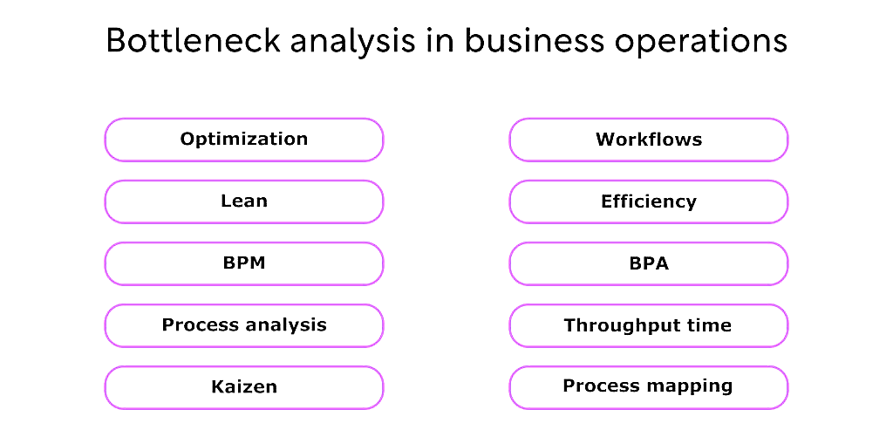
HOW TO CONDUCT BOTTLENECK ANALYSIS
Source: process maker; https://www.processmaker.com/blog/bottleneck-analysis-explained

Slide 9
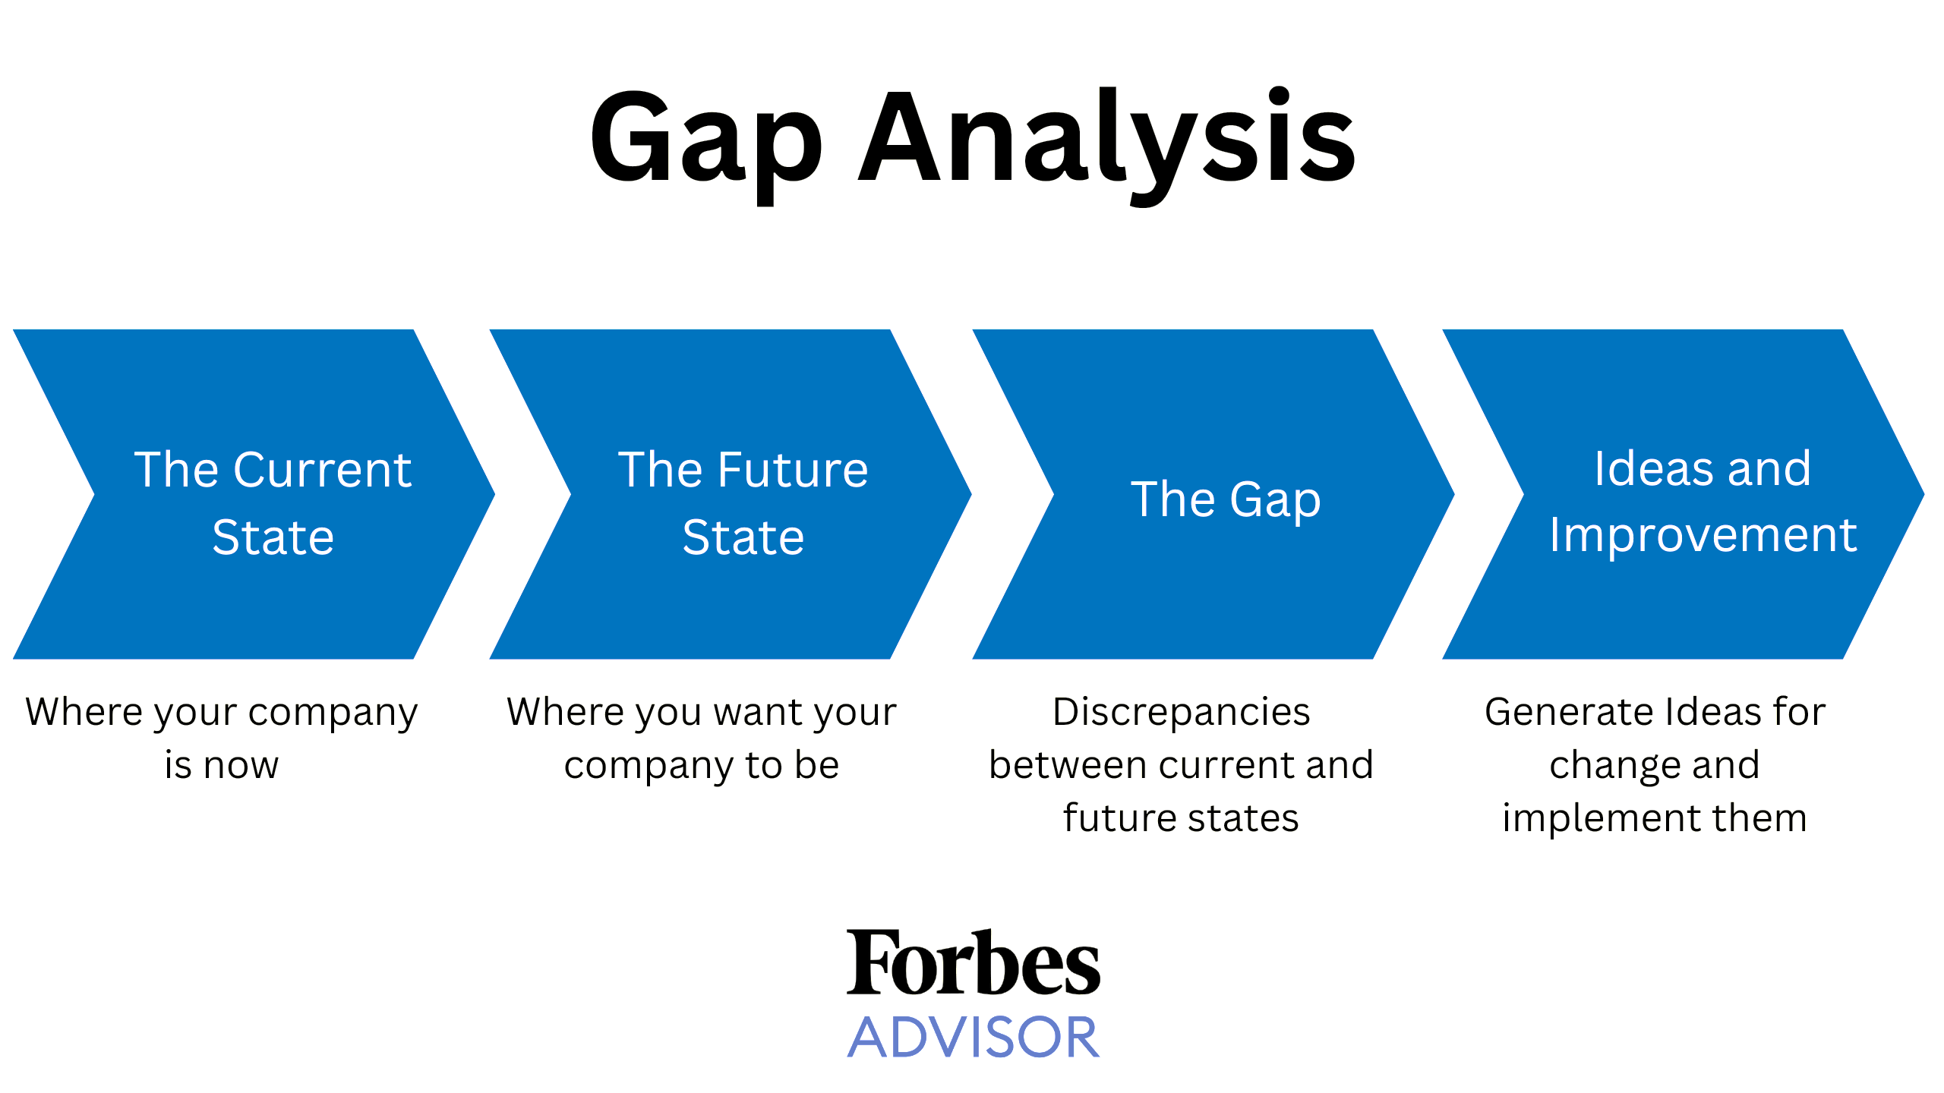
GAP ANALYSIS
What is gap analysis
“A gap analysis is the process of analyzing where a company or process is, where it should be, the differences between the two and determining how to implement change.”
When to conduct gap analysis
“A gap analysis should be considered when a company experiences significant ‘corporate pain,’ such as consistently missing key metrics, teams failing to meet their goals, or persistent people-related challenges like low employee engagement and high turnover. These issues are often symptoms of a deeper ‘fundamental misalignment.”
The Four Stages of Gap Analysis
Source: Forbes; https://www.forbes.com/advisor/business/gap-analysis-template/

Slide 10
THE FOUR STAGES OF GAP ANALYSIS
The Current State
“The first stage of gap analysis is to take a long, hard look at where your business or a certain process is.” Example: If you want to improve a process in managing projects, it may involve:
Market gaps. The difference between your budgeted and actual sales.
Resource gaps. The number of team members available for the amount of work which is a critical component of resource management.
Performance gaps. The difference between expected and actual performance regarding task and project due dates.
Budget gaps. The difference between actual spend and budgeted amount, which could be especially helpful when trying to combat scope creep. To help you get an even better grip on your finances, you can conduct a cost-benefit analysis.”
The Future State
Involves determining the overall objective a business is aiming at. Examples:
Tasks to be completed in a given time frame
Increasing the number of customers by a certain percentage
Number of employees to have on a specific sales goal
Source: Forbes; https://www.forbes.com/advisor/business/gap-analysis-template/

Slide 11
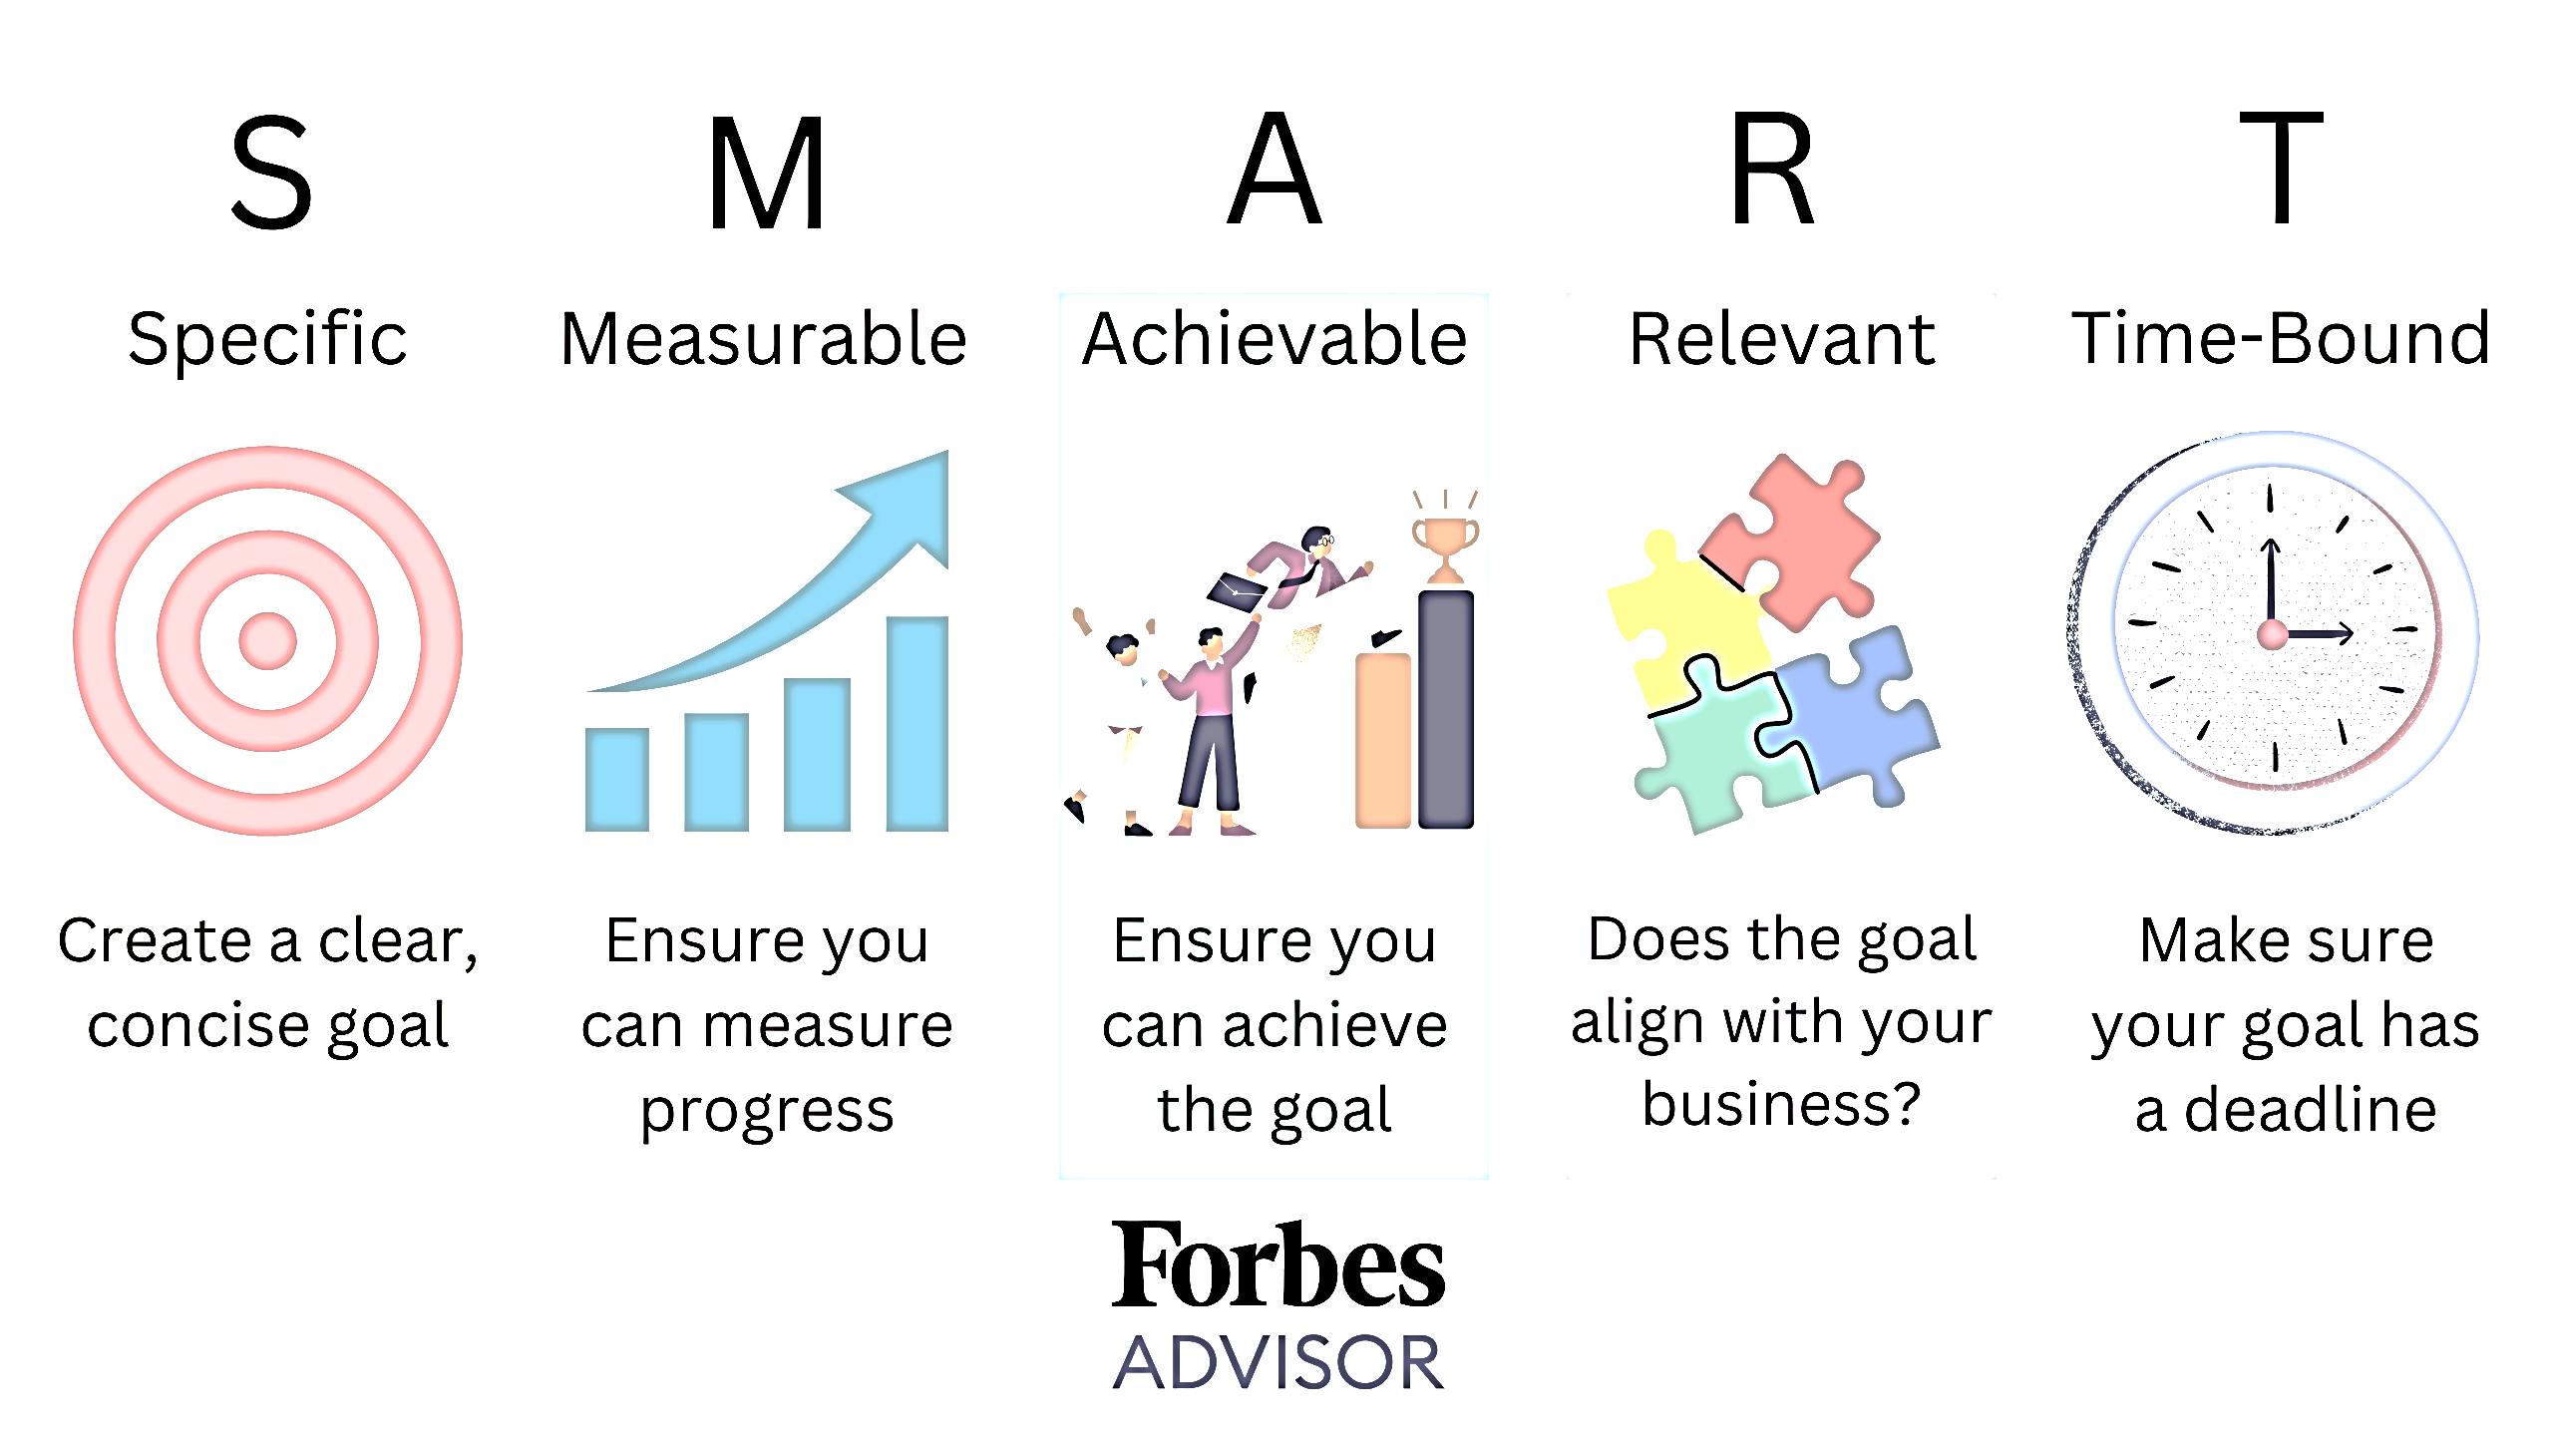
THE FOUR STAGES OF GAP ANALYSIS
The Gap
Involves determining the deficiencies between the current and future state. Example:
Sales have decreased due to poor marketing or staff training
Tasks are not being completed due to poor staffing
Ideas and Improvement
Involves using the S.M.A.R.T. goal framework to define specific, measurable, achievable, relevant and time-bound goals that can help take you from your current state to your desired future state. Example:
We will increase the successful completion of tasks by their due date from 65% to 85%. We will achieve this by teaching how to manage time, how to utilize project management software properly and ensuring that all required resources are readily available.
Source: Forbes; https://www.forbes.com/advisor/business/gap-analysis-template/

Slide 12
ACTIVITY
Out of the three methods suggested for business process improvement, identify your preferred method
Select one process that you think can be improved at your learning institution
Use your preferred method for improving that process

Slide 13
ESSENTIAL READINGS
Forbes: “Conducting a gap analysis”, available at https://www.forbes.com/advisor/business/gap-analysis-template/
IBM: “What is root cause analysis”, available at https://www.ibm.com/think/topics/root-cause-analysis
Kaizen Institute: “Understanding the Ishikawa Diagram?”, available at https://kaizen.com/insights/ishikawa-diagram-root-cause-analysis/
Processmaker: “Bottleneck analysis explained”, available at https://www.processmaker.com/blog/bottleneck-analysis-explained/

Slide 14
REFERENCE BOOKS OPTIONS
BUSINESS ANALYSIS BODY OF KNOWLEDGE (BABOK); IIBA Bookstore: https://www.iiba.org/career-resources/a-business-analysis-professionals-foundation-for-success/babok/
BUSINESS ANALYSIS (Fourth Edition) by Debra Paul (Author), James Cadle (Author), Malcolm Eva (Author), Craig Rollason (Author), Jonathan Hunsley (Author)
BUSINESS ANALYSIS TECHNIQUES: 123 ESSENTIAL TOOLS FOR SUCCESS (3RD Edition) by James Cadle (Author), Debra Paul (Author), Jonathan Hunsley (Author), Adrian Reed (Author)

